Slide 1


II Project Presentation (KCS 753) (Embelia: A Smart Health App)
KIET Group of Institutions, Ghaziabad
(An ISO – 9001: 2008 Certified & ‘A+’ Grade accredited Institution by NAAC)
Guide Name: Mr. Anurag Mishra
Project Members Name with Roll Number & Section
1. Pratyush Pandey (2000290120114) 7-B

Slide 2
Problem Statement
In today's fast-paced world, many individuals struggle to maintain their physical and mental well-being due to a lack of personalized guidance, motivation, and effective tracking. Common issues include difficulties in monitoring health activities, setting achievable goals, managing tasks, receiving tailored recommendations, addressing mental health concerns, and sustaining motivation. Several key problems are prevalent in this context:
1. Nutrition Challenges
2. Sleep Deprivation
3. Social Isolation
4. Work-Life Balance
5. Financial Stress
6. Procrastination
7. Lack of Access to Healthcare
8. Lack of Time
9. Substance Abuse
10. Emotional Resilience
11. Environmental Factors

Slide 3
Objectives Develop a user-friendly health tracking system for comprehensive data collection. Enable personalized goal setting and task management for improved well-being. Provide AI-driven recommendations and mental health support for holistic health enhancement.
Enhanced Health Tracking
Personalized Goal Achievement
Efficient Task Management
AI-Driven Recommendations
Mental Health Integration

Slide 4
Technology Used
Frontend Development
Flutter: For building the cross-platform mobile application with a native-like user interface.
Backend Development
MongoDB: As the NoSQL database for storing and managing application data.
Firebase: For backend services like authentication, real-time database, and cloud storage.
Machine Learning
Python: For implementing machine learning algorithms and models.
AWS (Amazon Web Services): For deploying and hosting machine learning scripts and models.
Flask: As the web framework for creating APIs and serving machine learning models through RESTful endpoints.

Slide 5
Literature Survey
Paper title: Lifestyle choices and mental health
Author name: Julia Velten, Angela Bieda, Saskia Scholten, André Wannemüller & Jürgen Margraf
Journal Name: Lifestyle choices and mental health: a longitudinal survey with German and Chinese students.
Year of publishing: 16 May 2018
Summary: Investigating a broad range of lifestyle choices in German and Chinese students showed that lifestyle has a significant impact on students’ psychological, emotional, and social well-being as well as on symptoms of mental health difficulties. Across samples, a lower body mass index, more frequent physical and mental activities, non-smoking, a non-vegetarian diet, and a more regular social rhythm were associated with better mental health. While some differences between German and Chinese students emerged, a multi-group model showed that most lifestyle factors predict students’ mental health similarly across countries. As some lifestyle choices—physical activity, non-smoking, and a more regular social rhythm—predicted the state of future mental health when controlling for age, gender, and baseline mental health, interventions promoting lifestyle changes in students may be effective in improving students’ mental health.

Slide 6
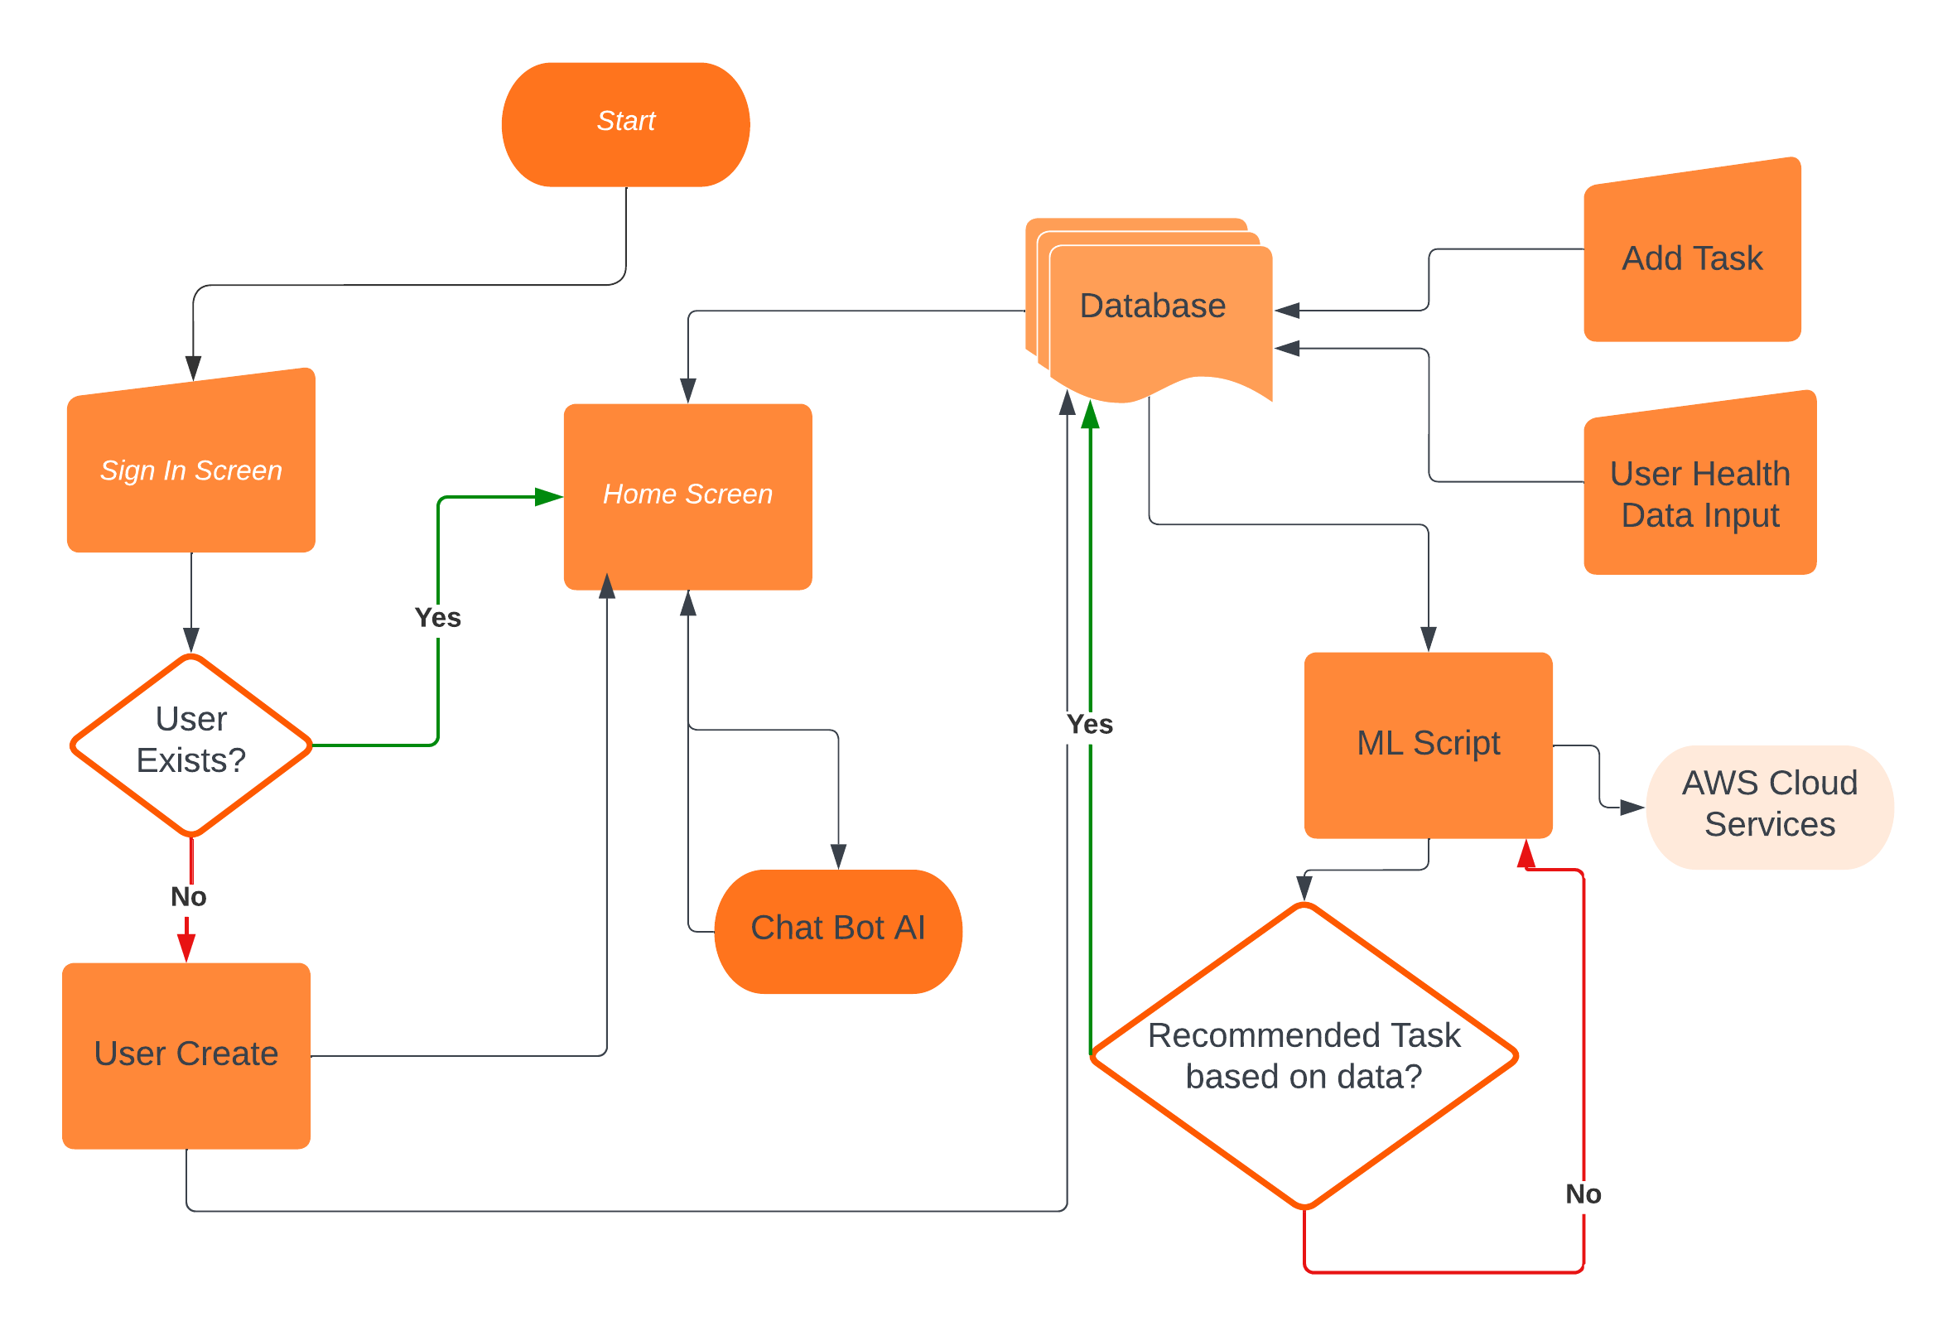
Workflow Diagram

Slide 7
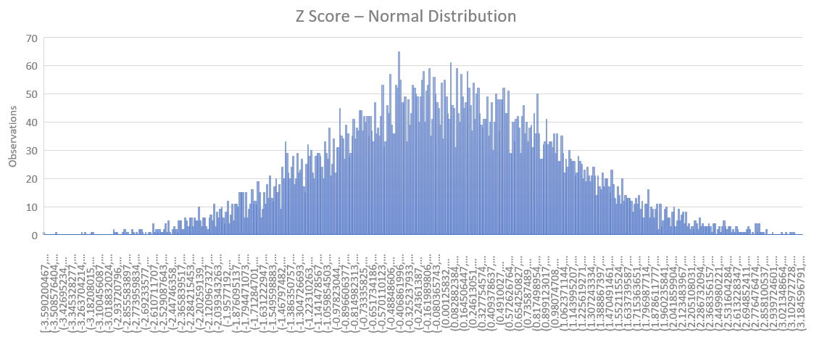
Workflow Diagram

Slide 8
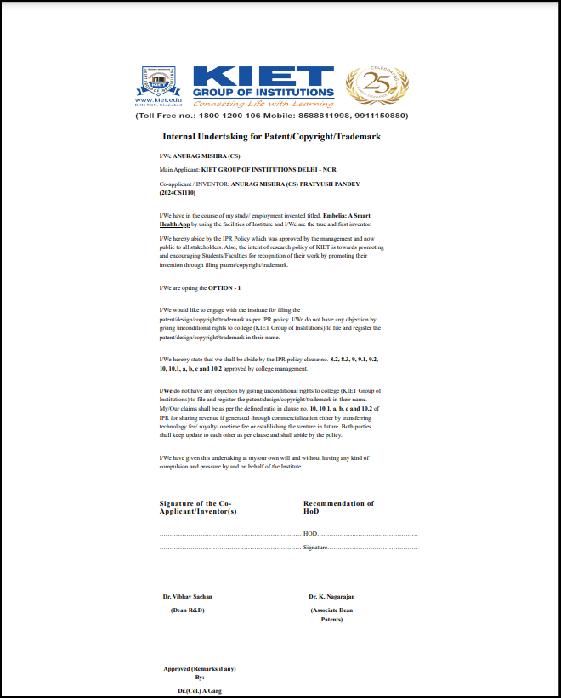
Patent Status
Soft copy proof of submission/ publication.

Slide 9
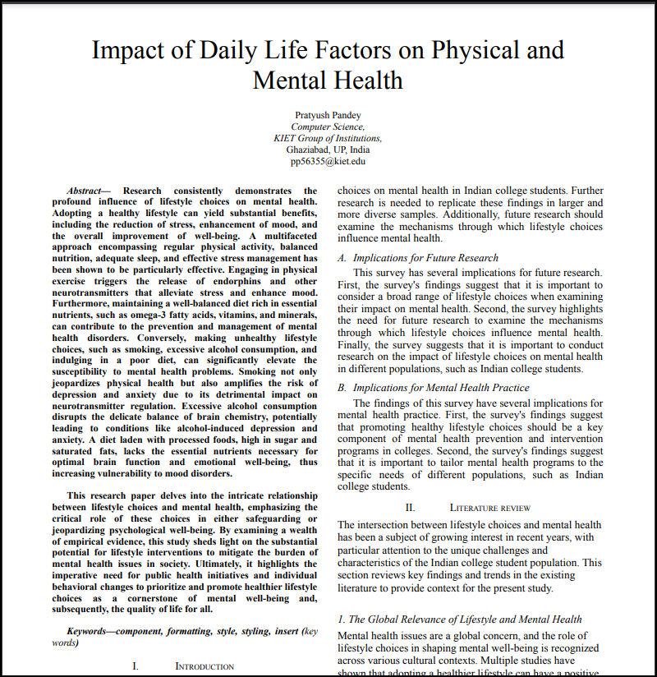
Research Paper Status
Soft copy proof of submission/ publication.
Draft completion status

Slide 10
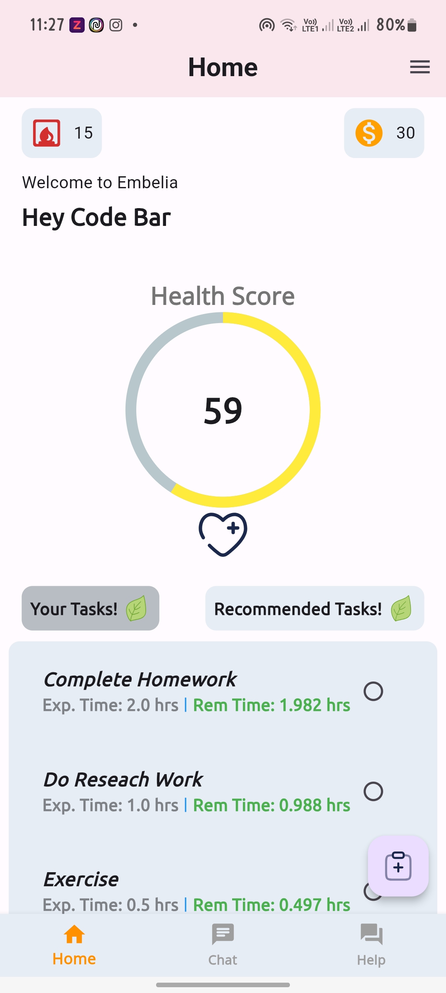
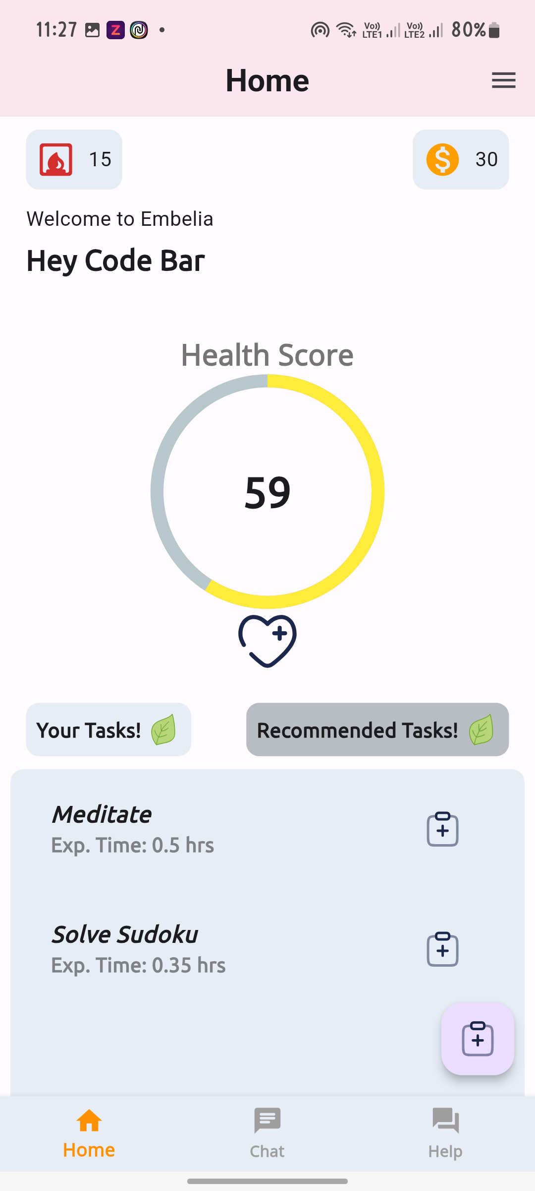
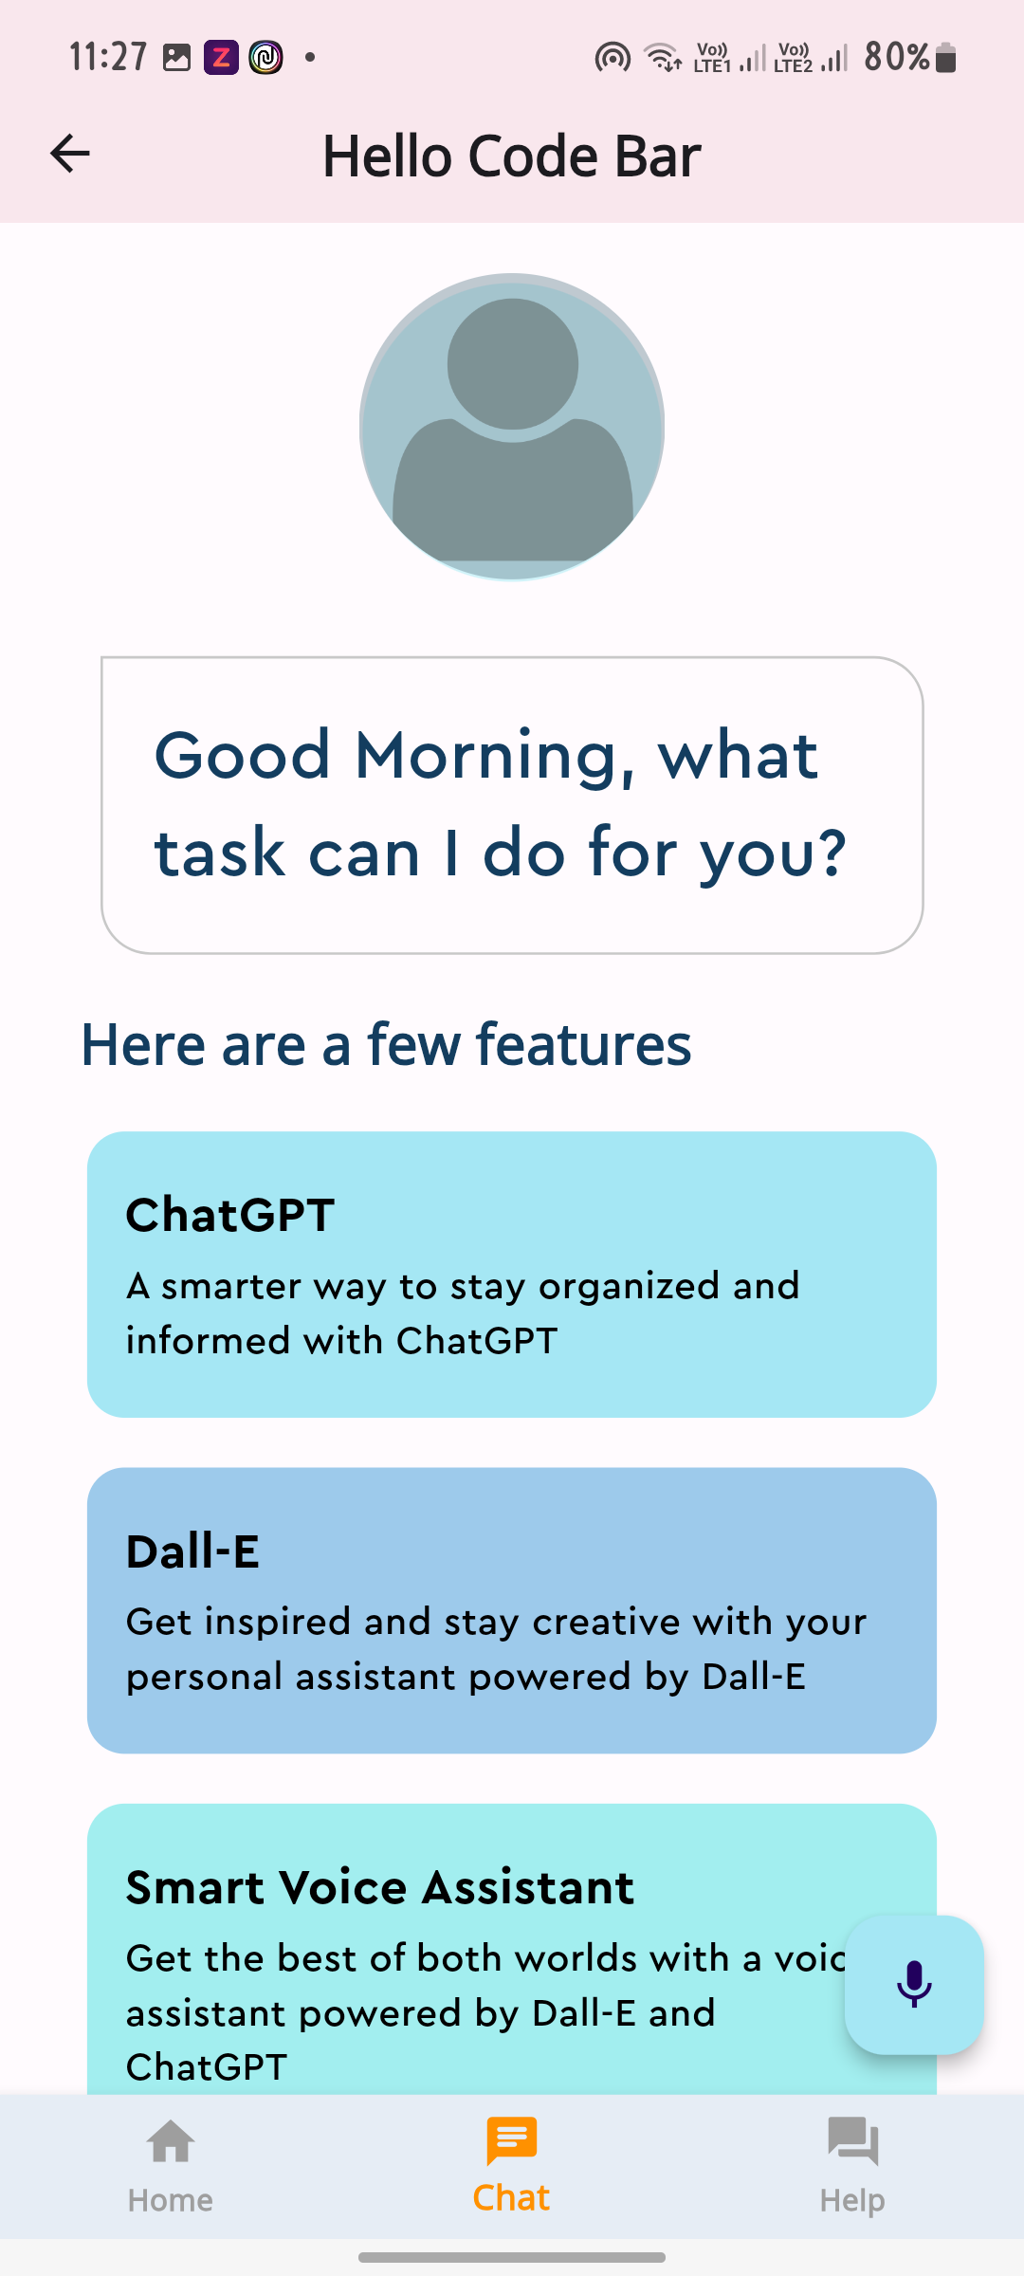
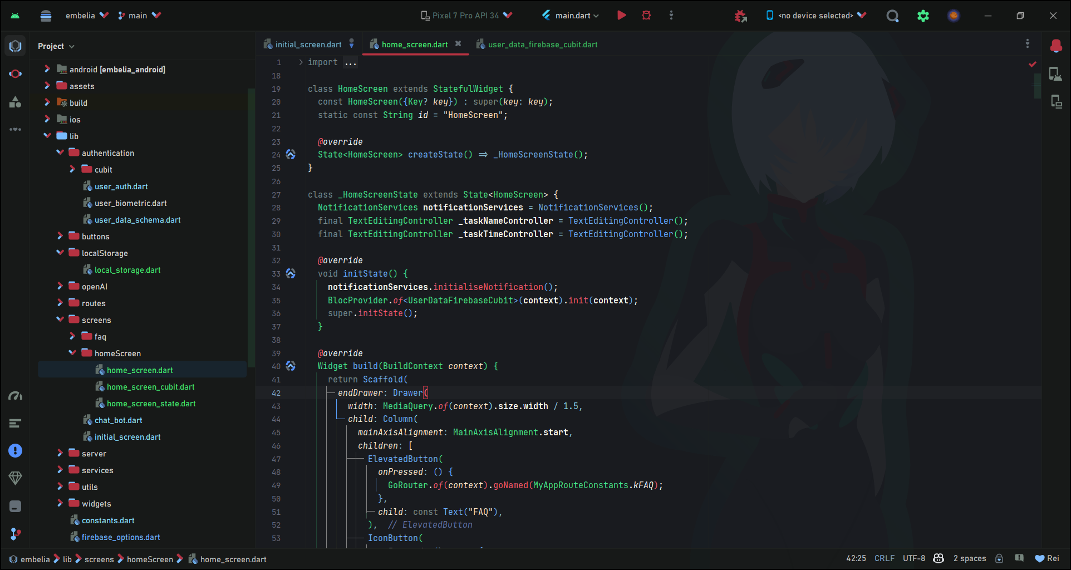
Project Status: The project is currently at the 95% mark of completion.

Slide 11
References
Herrman H, Saxena S, Moodie R. Promoting mental health: concepts, emerging evidence, practice: a report of the World Health Organization, Department of Mental Health and Substance Abuse in collaboration with the Victorian Health Promotion Foundation and the University of Melbourne: World Health Organization; 2005.
Wittchen HU, Jacobi F, Rehm J, Gustavsson A, Svensson M, Jönsson B, et al. The size and burden of mental disorders and other disorders of the brain in Europe 2010. Eur Neuropsychopharmacol. 2011;21:655–79.
World Health Organization. Mental health: strengthening our response. Fact sheet Nr. 220. Geneva: World Health Organization; 2014.
Vaillant GE. Positive mental health: is there a cross-cultural definition? World Psychiatry. 2012;11:93–9.
World Health Organization. The ICD-10 classification of mental and behavioural disorders: diagnostic criteria for research. Geneva: World Health Organization; 1993.
Schönfeld P, Brailovskaia J, Bieda A, Zhang XC, Margraf J. The effects of daily stress on positive and negative mental health: mediation through self-efficacy. Int J Clin Heal. 2016;16:1–10.
American Psychiatric Association. Diagnostic and statistical manual of mental disorders. 5th revision ed. Washington, DC; 2013.
World Health Organization. The ICD-10 classification of mental and behavioural disorders: diagnostic criteria for research. Geneva: World Health Organization; 1993.
Keyes CLM. Social well-being. Soc Psychol. 1998:121–40.
Waterman AS. Two conceptions of happiness: contrasts of personal expressiveness (eudaimonia) and hedonic enjoyment. J Pers Soc Psychol. 1993;64:678–91.

